Slide 1
UNIT 4
GREEDY METHOD

Slide 2
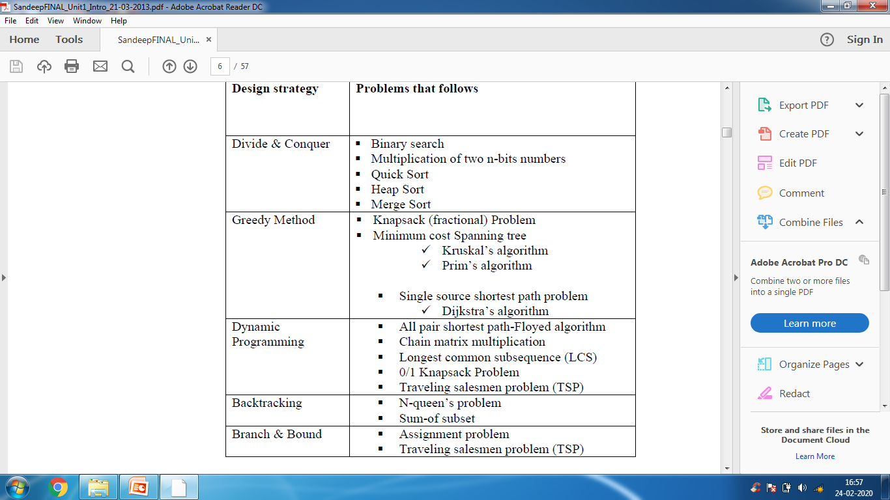
DESIGN STRATEGY

Slide 3
INTRODUCTION
The greedy method is the most straightforward design technique and it can be applied to a wide variety of problems.
Most of these problems have n inputs & require us to obtain a subset that satisfies some constraint.
In an optimization problem, a set of constraints and an optimization function (objective function) are given.

Slide 4
OPTIMIZATION PROBLEM
FEASIBLE SOLUTION: a solution that is a subset for “n” inputs & that satisfies some constraints is called a feasible solution.
OPTIMAL SOLUTION: A feasible solution that either maximizes or minimizes a given optimization function or objective function (i.e. having the best possible value) is called an optimal solution.

Slide 5
GREEDY METHOD
Greedy method says that a problem should be solved in stages.
In each stage we will consider one input from a given problem and if that input is feasible then we will include it the solution.
So by including all those feasible inputs we will get optimal solution.

Slide 6
GREEDY CRITERION
The criterion that is used to make the greedy decision at each stage (i.e. whether a particular input is in the optimal solution) is called the Greedy criterion.
The greedy approach suggests construction a solution through a sequence of steps, each expanding a partially constructed solution obtained so far, until a complete solution to the problem is reached.

Slide 7
GREEDY CRITERION
On each step, the choice made must be
Feasible i.e. it has to satisfy the problem’s constraints
Locally optimal i.e. it has to be the best local choice among all feasible choices available on that step
Irrevocable i.e. once made, it cannot be changed on subsequent steps of the algorithm
On each step, it suggests a “greedy” grab of the best alternative available in the hope that a sequence of locally optimal choices will yield a globally optimal solution to the entire problem.

Slide 8
GREEDY TECHNIQUE
Subset paradigm
Ordering paradigm

Slide 9
GREEDY TECHNIQUE
Subset paradigm: In this, a decision of whether or not a particular input is in an optimal solution is made by considering the inputs in an order determined by some selection procedure. The selection procedure itself is based on some optimization measure. This measure may be the objective function.
Algorithms that fall under subset paradigm are
Knapsack problem
Job sequencing with deadlines
Minimum cost spanning trees

Slide 10
GREEDY TECHNIQUE
Ordering paradigm: In this, the decisions are made by considering the inputs in some order. Each decision is made using an optimization criterion that can be computed using decisions already made.
Algorithms that fall under subset paradigm are
Single source shortest paths
Topological ordering

Slide 11
GREEDY PROCEDURE
The array a[1,2,……n] contains “n” inputs.
Greedy( a[], n)
{
solution = 0 //the solution is initialized to be empty
for i = 1 to n
{
x = select(a); //function select, selects an input from an array
if feasible(x) then // feasible is a Boolean valued function that finds whether x can be included into the solution vector
solution=solution + x;
}
Return solution;
}

Slide 12
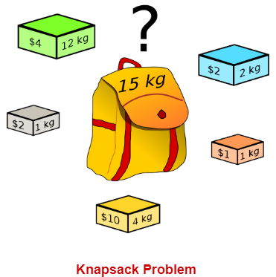
Knapsack Problem
Given a set of items, each with a weight and a value, determine a subset of items to include in a collection so that the total weight is less than or equal to a given limit and the total value is as large as possible.

Slide 13
Problem Scenario
A thief is robbing a store and can carry a maximal weight of W into his knapsack. There are n items available in the store and weight of i^{th} item is w_{i} and its profit is p_{i}. What items should the thief take?
In this context, the items should be selected in such a way that the thief will carry those items for which he will gain maximum profit. Hence, the objective of the thief is to maximize the profit.

Slide 14
CATEGORY
Based on the nature of the items, Knapsack problems are categorized as
Fractional Knapsack: Fractions of object can be placed
0/1 Knapsack: Object can be placed as a whole.

Slide 15
Fractional Knapsack
In this case, items can be broken into smaller pieces, hence the thief can select fractions of items.
According to the problem statement,
There are n items in the store
Weight of i^{th} item W_{i}>0
Profit for i^{th} item P_{i} >0 and
Capacity of the Knapsack is W
In this version of Knapsack problem, items can be broken into smaller pieces. So, the thief may take only a fraction x_{i} of i^{th} item.
0⩽X_{i}⩽1

Slide 16
Fractional Knapsack
The i^{th} item contributes the weight x_{i}w_{i} to the total weight in the knapsack and profit x_{i} p_{i} to the total profit.
Hence, the objective of this algorithm is to maximize∑(x_{i} p_{i}) subject to constraint, ∑(x_{i} w_{i})⩽W
It is clear that an optimal solution must fill the knapsack exactly, otherwise we could add a fraction of one of the remaining items and increase the overall profit.
Thus, an optimal solution can be obtained by ∑(x_{i} w_{i})=W
In this context, first we need to sort those items according to the value of pi/wi.

Slide 17
Different Strategies
To find solution for the knapsack problem, different strategies can be followed.
Select the objects based on increasing order of weights.
Select the objects based on decreasing order of profits.
Select the objects based on decreasing order of pi/wi
Select the objects based on increasing order of pi/wi

Slide 18
EXAMPLES
For the knapsack problem, n=3, m=20, (p1,p2,p3) = (25,24,15) and (w1,w2,w3) = (18,15,10), find the feasible solutions and the optimal solution
For the knapsack problem, n=7, m=15, (p1,p2…p7) = (10,5,15,7,6,18,3) and (w1,w2…w7) = (2,3,5,7,1,4,1), find the feasible solutions and the optimal solution
For the knapsack problem, n=5, m=15, (p1,p2..p5) = (4,2,2,1,10) and (w1,w2..w5) = (12,1,2,1,4), find the feasible solutions and the optimal solution

Slide 19
ALGORITHM
In the knapsack problem, p[1,2,…n] and w[1,2,…n] contain the profits and weights respectively of the “n” objects ordered such that p[i+1]/w[i+1]>p[i]/w[i]. “m” is the knapsack size and x[1,2,…n] is the solution vector

Slide 20
KNAPSACK ALGORITHM
Read the no of objects and store in num variable.
Read the weight and profit of n objects using loop (weight[] and profit[])
Read the capacity of knapsack and store in capacity variable.
Find the ratio of each object, profit[]/weight[]
Do the sort procedure, which returns the array of the object numbers according to the descending order of value of (profit/weight)
Call the knapsack procedure

Slide 21
Knapsack procedure
Assign the elements of the array x[] to 0
By comparing the weight of the object and capacity of knapsack fill the object to knapsack.
Assign value 1 to x[] for that object.
Add profit of object which is placed in knapsack.
Subtract the knapsack capacity by weight of object
If the knapsack is not completely filled and the object weight is larger, then place the part of the object by dividing the knapsack capacity by weight of object
Add the profit of object as x[]*p[]
Print the solution vector x[] for each object
Print the optimal solution i.e. maximum profit
Return to main program

Slide 22
FRACTIONAL KNAPSACK PROGRAM
PROGRAM

Slide 23
Time Complexity
The main time taking step is the sorting of all items in decreasing order of their value / weight ratio.
If the items are already arranged in the required order, then loop takes O(n) time.
The average time complexity of Quick Sort is O(nlogn).
Therefore, total time taken including the sort is O(nlogn).

Slide 24
JOB SEQUENCING WITH DEADLINES
TASK SCHEDULING

Slide 25
PROBLEM STATEMENT
There are a set of “n” jobs. Associated with job “i” is an integer deadline d_{i} =0 and a profit p_{i} >0
For any job “i” , the profit “p_{i}” is earned if and only if the job is completed by its deadline.
To complete a job, it has to be processed on a machine for one unit of time.
Only one machine is available for processing jobs.

Slide 26
FEASIBLE SOLUTION
A feasible solution is a subset “J” of jobs such that each job in this subset can be completed by its deadline.
The value of the feasible solution “J” is the sum of the profits of the jobs in “J”

Slide 27
OPTIMAL SOLUTION
An optimal solution is a feasible solution with maximum value.
Since the problem involves the identification of a subset, it fits the subset paradigm.
An optimization measure must be formulated to determine how the next job is chosen.
The objective function ∑P_{i} (where i belongs to J) is chosen as the optimization measure.
The next job to be included is the one that increases ∑P_{i} subject to the constraint that the resulting “J” is a feasible solution.
The job that has the largest profit is added. It forms the feasible solution.

Slide 28
OPTIMAL SOLUTION
The next job to join the set {J} has to satisfy the following conditions:
The job should have maximum profit so as to form an optimal solution.
The job to be included should be completed by its deadline to form a feasible solution.
To find the optimal solution and feasibility of jobs we are required to find a subset J such that each job of this subset can be completed by its deadline. The value of a feasible solution J is the sum of profits of all jobs in J

Slide 29
JOB SEQUENCING WITH DEADLINES PROBLEMS
Solve the job sequencing problem with number of jobs n=4, their profits are (p1,p2,p3,p4) = (100,10,15,27) and deadlines are (d1,d2,d3,d4)=(2,1,2,1)
Solve the job sequencing problem with number of jobs n=5, their profits are (p1,p2,p3,p4,p5)=(20,15,10,5,1) and deadlines are (d1,d2,d3,d4,d5)=(2,2,1,3,3)
Solve the job sequencing problem with number of jobs n=5, their profits are (p1,p2,p3,p4,p5)=(1,5,20,15,10) and deadlines are (d1,d2,d3,d4,d5)=(1,2,4,1,3)

Slide 30
Solve the job sequencing problem with number of jobs n=4, their profits are (p1,p2,p3,p4) = (100,10,15,27) and deadlines are (d1,d2,d3,d4)=(2,1,2,1)
Maximum deadline units = 2
Maximum number of jobs that form the feasible solution = 2
Feasible solution | Processing Sequence | Value
J1, J2 J1, J3 J1, J4 J2, J3 J3, J4 J1 J3 J2 J4 | J2, J1 J1, J3 J4, J1 J2, J3 J4, J3 J1 J3 J2 J4 | 10 +100 =110 100 + 15 =115 27 + 100 =127 10 + 15 =25 27 + 15 = 42 100 15 10 27
Optimal solution is the one that maximizes profit. So feasible solution 3 is optimal solution with profit 127.

Slide 31
MINIMUM COST SPANNING TREES

Slide 32
SPANNING TREES
A spanning tree is a subset of an undirected Graph that has all the vertices connected by minimum number of edges.
If all the vertices are connected in a graph, then there exists at least one spanning tree. In a graph, there may exist more than one spanning tree.
Properties
A spanning tree does not have any cycle.
Any vertex can be reached from any other vertex.

Slide 33
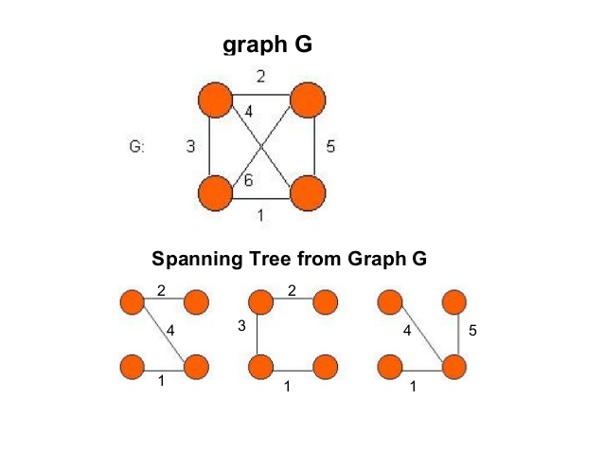
EXAMPLE: SPANNING TREES

Slide 34
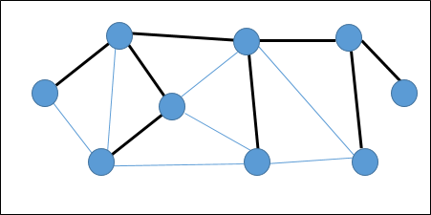
EXAMPLE: SPANNING TREES
In the following graph, the highlighted edges form a spanning tree.

Slide 35
MINIMUM COST SPANNING TREE
A Minimum Spanning Tree (MST) is a subset of edges of a connected weighted undirected graph that connects all the vertices together with the minimum possible total edge weights.
To obtain a MST, the greedy method builds this tree edge by edge. The next edge to be included is chosen according to some optimization criterion. The simplest such criterion is to choose an edge that results in a minimum increase in the sum of the costs of the edges so far included.
A minimum spanning tree has (V – 1) edges where V is the number of vertices in the given graph
There are two possible ways to derive an MST,
Prim’s algorithm
Kruskal’s algorithm

Slide 36
Applications of Minimum Spanning Tree
Network design: (telephone, electrical, hydraulic, TV cable, computer, road) The standard application is to a problem like phone network design. You have a business with several offices; you want to lease phone lines to connect them up with each other; and the phone company charges different amounts of money to connect different pairs of cities. You want a set of lines that connects all your offices with a minimum total cost. It should be a spanning tree, since if a network isn’t a tree you can always remove some edges and save money.
Solve travelling salesman problem
Obtain circuit equations in electric network.

Slide 37
Kruskal’s algorithm
Below are the steps for finding MST using Kruskal’s algorithm
1. Sort all the edges in non-decreasing order of their weight
2. Pick the smallest edge. Check if it forms a cycle with the spanning tree formed so far. If cycle is not formed, include this edge. Else, discard it. 3. Repeat step#2 until there are (V-1) edges in the spanning tree.

Slide 38
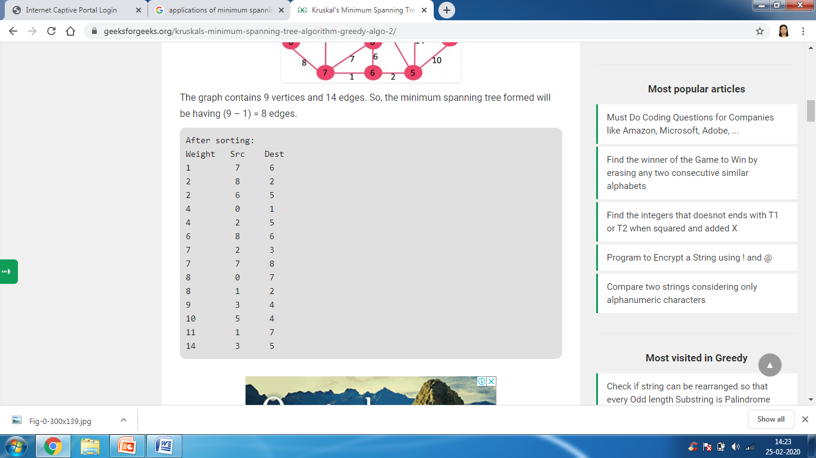
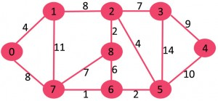
Kruskal’s algorithm “EXAMPLE”
Total cost= 4+8+1+2+4+2+7+9 = 37

Slide 39
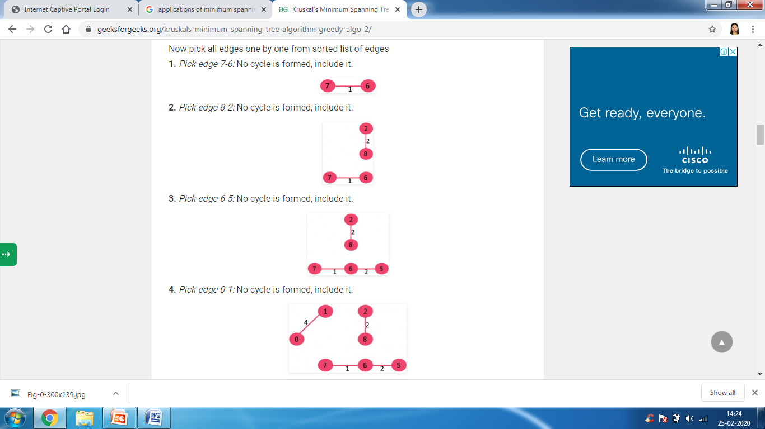

Slide 40
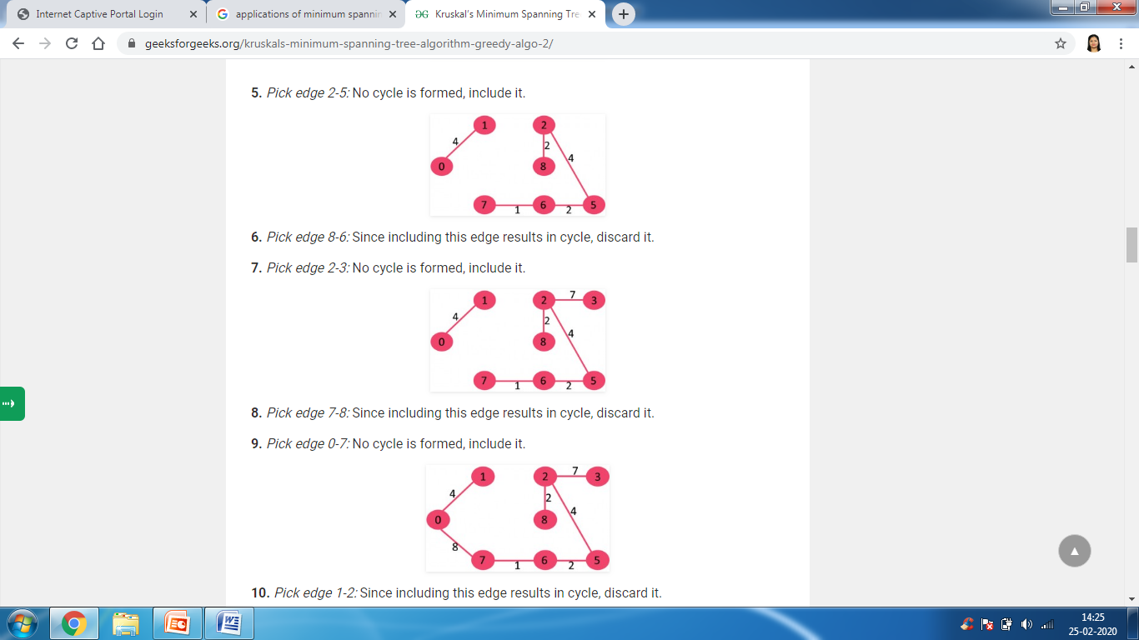
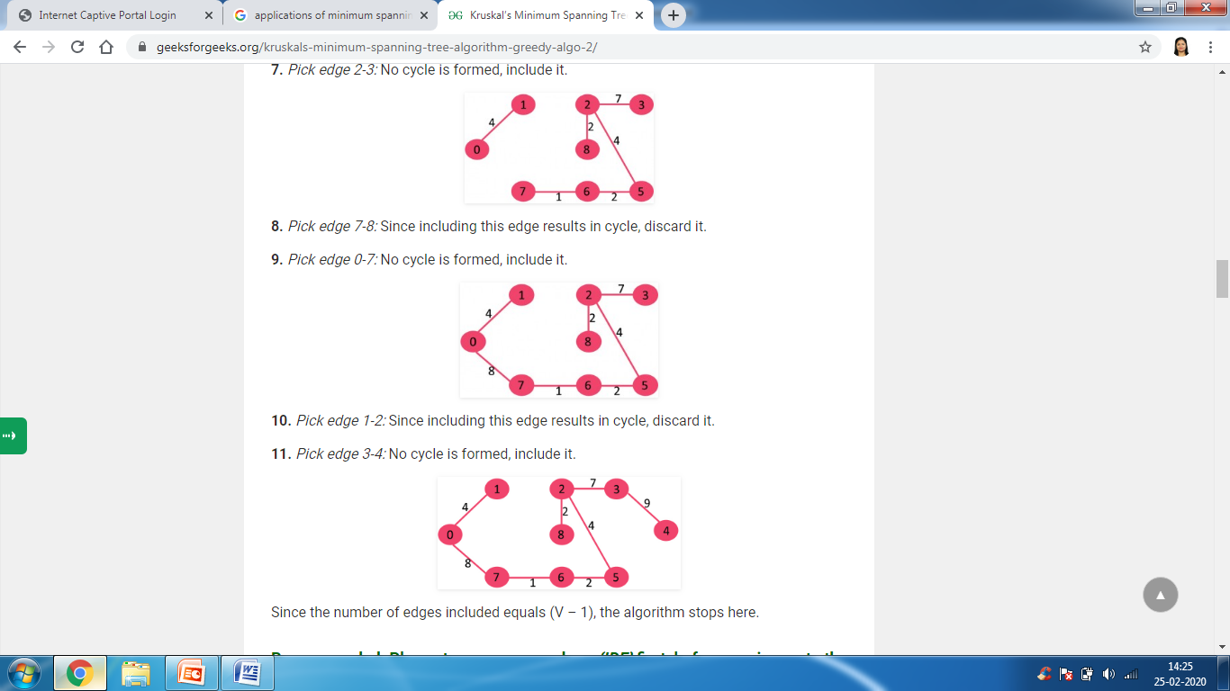

Slide 41
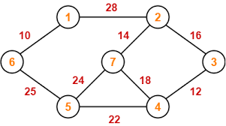
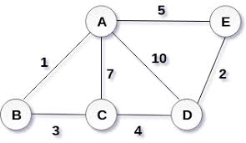
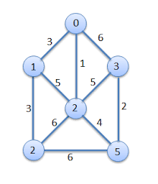
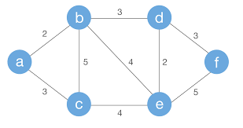
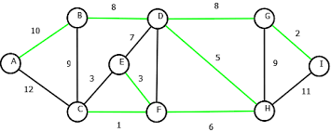
Kruskal’s algorithm Problems

Slide 42
Kruskal’s algorithm
To find a MST in an “n” vertex graph, E is the set of all edges in graph G, t is the sets of selected edges
initialize t=empty or NULL;
while ( t has less than n -1 edges)
{
choose an edge (u,v) from E of least cost;
E = E – {(U,V)};
if (u,v) does not create a cycle in t
add (u,v) to t
else
discard (u,v);
}

Slide 43
Kruskal’s algorithm “PROGRAM”
Implementation of Kruskal's algorithm using adjacency matrix.
PROGRAM

Slide 44
Time Complexity
The time complexity of Kruskal’s algorithm depends on the data structures used for the graph and for ordering the edges by weight.
Data Structure of Graph: Adjacency Matrix
O(|V| + |E| log |E|) — We need to initialize all |V| vertices, and we need to sort all |E| edges. Note that the fastest algorithms to sort a list of n elements are O(n log n﻿).

Slide 45
Prim’s ALGORITHM
Prim’s algorithm is a greedy algorithm.
It finds a minimum spanning tree for a weighted undirected graph.
This means it finds a subset of the edges that forms a tree that includes every vertex, where the total weight of all the edges in the tree is minimized.
The algorithm operates by building this tree one vertex at a time, from an arbitrary starting vertex, at each step adding the cheapest possible connection from the tree to another vertex.
To apply Prim’s algorithm, the given graph must be weighted, connected and undirected.

Slide 46
Prim’s Algorithm Implementation
Step-01:
Randomly choose any vertex.
The vertex connecting to the edge having least weight is usually selected.
Step-02:
Find all the edges that connect the tree to new vertices.
Find the least weight edge among those edges and include it in the existing tree.
If including that edge creates a cycle, then reject that edge and look for the next least weight edge.
Step-03:
Keep repeating step-02 until all the vertices are included and Minimum Spanning Tree (MST) is obtained.

Slide 47
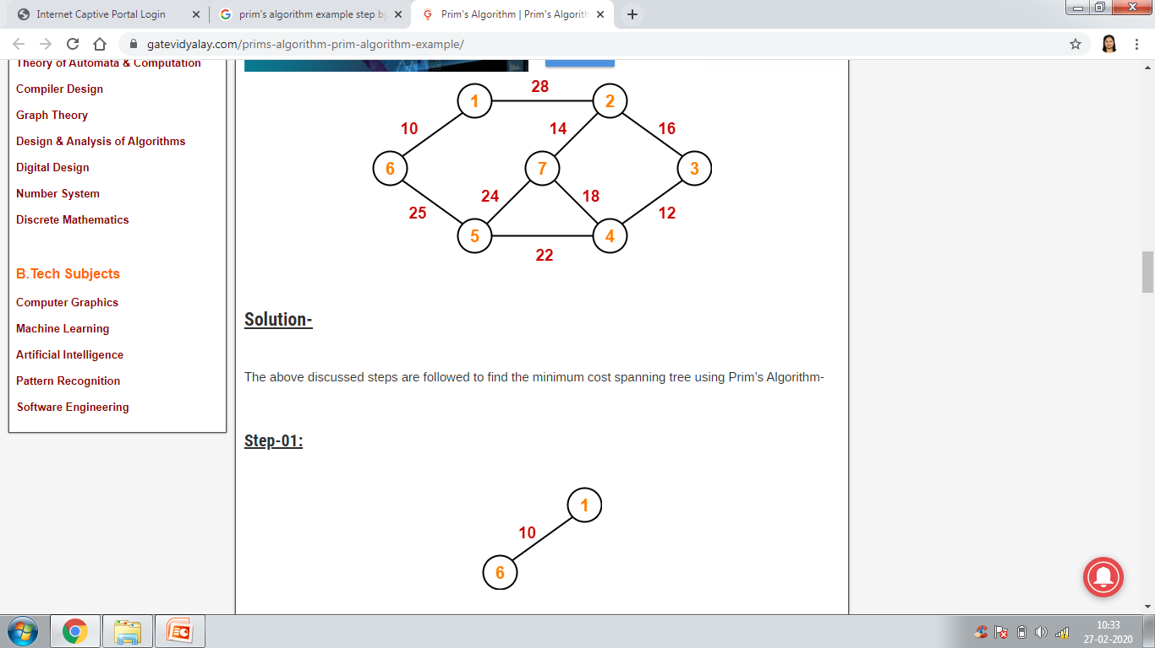
EXAMPLE: Prim’s ALGORITHM

Slide 48
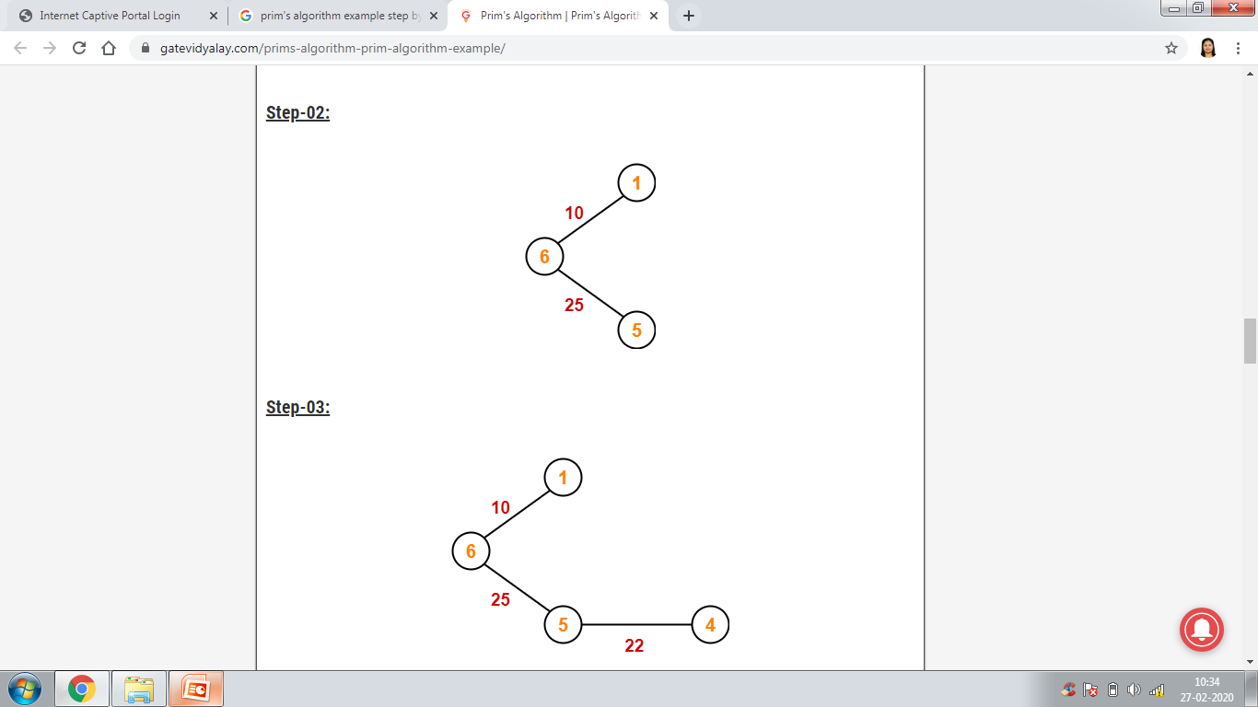
EXAMPLE: Prim’s ALGORITHM

Slide 49
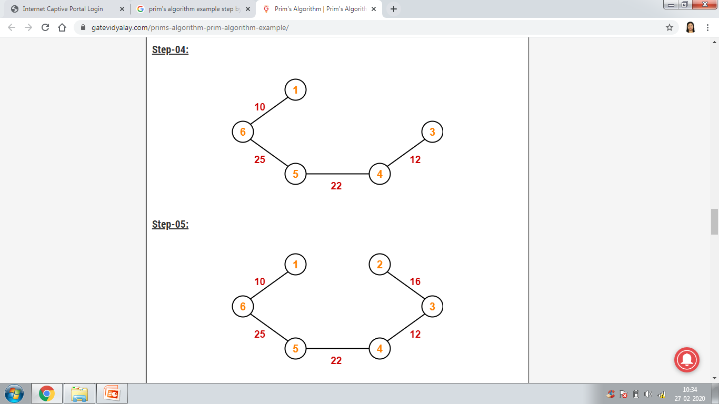
EXAMPLE: Prim’s ALGORITHM

Slide 50
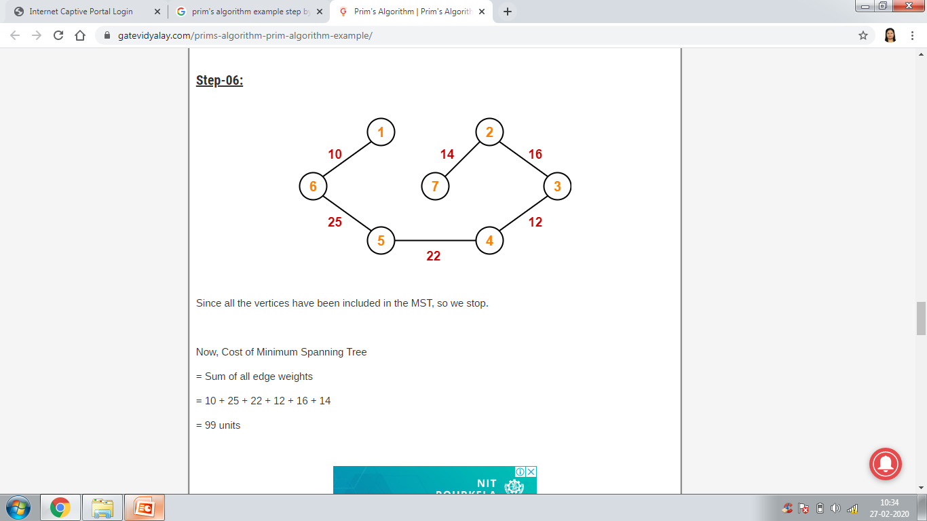
EXAMPLE: Prim’s ALGORITHM

Slide 51
Prim’s algorithm Problems

Slide 52
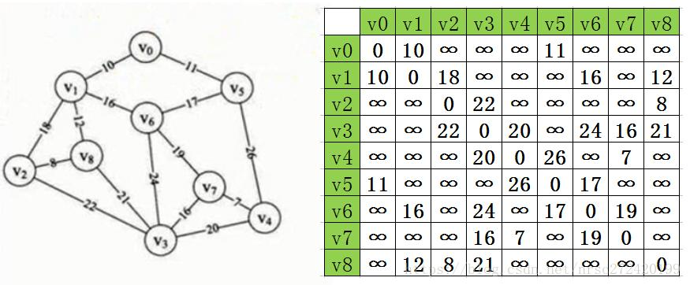
Implementation of Prim’s Algorithm using adjacency matrix

Slide 53
Prim’s algorithm steps using Adjacency matrix
Initialize the values using adjacency matrix
Initialize visited[1] =1
Repeat the steps until no of edges < no of vertex
Find the minimum value from each row
Check the value of visited array of that vertex
Print the edge with cost
Calculate minimum cost
Change the visited array
Replace the cost of edges to max value 999, so that it will not count for next row

Slide 54
Prim’s algorithm “PROGRAM”
Implementation of Prim's algorithm using adjacency matrix.
PROGRAM

Slide 55
Shortest Path Problem

Slide 56
Shortest Path Problem
Shortest path problem is a problem of finding the shortest path(s) between vertices of a given graph.
Shortest path between two vertices is a path that has the least cost as compared to all other existing paths.
Shortest Path Algorithms- Shortest path algorithms are a family of algorithms used for solving the shortest path problem.

Slide 57
Applications
Shortest path algorithms have a wide range of applications such as in-
Google Maps
Road Networks

Slide 58
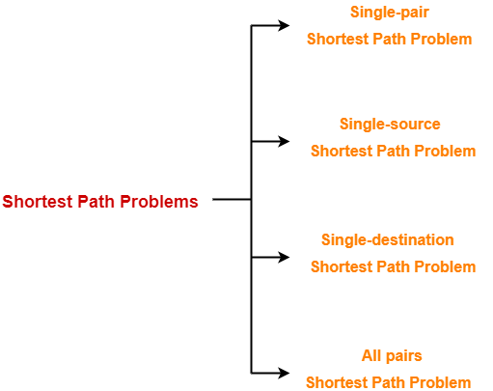
Types of Shortest Path Problem

Slide 59
Single-Source Shortest Path Problem
It is a shortest path problem where the shortest path from a given source vertex to all other remaining vertices is computed.
Dijkstra’s Algorithm and Bellman Ford Algorithm are the famous algorithms used for solving single-source shortest path problem.

Slide 60
Dijkstra Algorithm
It is important to note the following points regarding Dijkstra Algorithm-
Dijkstra algorithm is a very famous greedy algorithm.
It is used for solving the single source shortest path problem.
It computes the shortest path from one particular source node to all other remaining nodes of the graph.
Dijkstra algorithm works only for connected graphs.
Dijkstra algorithm works only for those graphs that do not contain any negative weight edge.
It provides the value or cost of the shortest paths.
Dijkstra algorithm works for directed as well as undirected graphs.

Slide 61
Implementation of Dijkstra Algorithm
Step-01: Initialization
Assign the 0 distance value to node s, and label it as permanent (0, p)
Assign to every node a distance value of ∞ and label them as temporary (∞ , t)
Designate the node s as the current node.

Slide 62
Implementation of Dijkstra Algorithm
Step-02: Distance value update and current node designation update.
Let i be the index of the current node
Find the set J of nodes with temporary labels that can be reached from the current node i by a link (i,j) . Update the distance values of these nodes. For each j ∈ J, the distance value d_{j} of node j is updated as follows new d_{j} = min (d_{j}, d_{i} + c_{jj}) where c_{ij} is the cost of link (i,j) as given in the network problem.
Determine a node j that has the smallest distance value d_{j} among all nodes j ∈ J
Change the label of node j (above step) to permanent and designate this node as current node.

Slide 63
Implementation of Dijkstra Algorithm
Step-03:Termination criterion
If all nodes that can be reached from node S have been permanently labeled, then the algorithm terminates. If we can not reach any temporary labeled node from the current node, then all the temporary labels become permanent.
Otherwise go to step 2

Slide 64
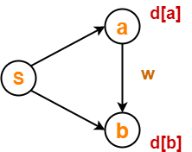
What is Edge Relaxation?
Consider the edge (a,b) in the following graph-
Here, d[a] and d[b] denotes the shortest path estimate for vertices a and b respectively from the source vertex ‘S’.
Now, If d[a] + w < d[b]
then d[b] = d[a] + w and predecessor of [b] = a
This is called as edge relaxation.

Slide 65
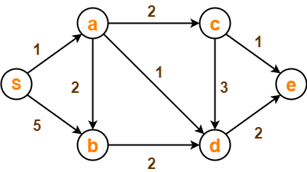
PROBLEM
Using Dijkstra’s Algorithm, find the shortest distance from source vertex ‘S’ to remaining vertices in the following graph. Also, write the order in which the vertices are visited.

Slide 66
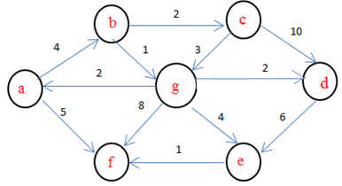
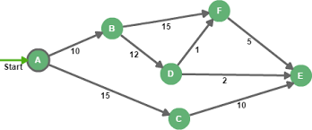
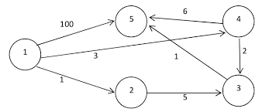
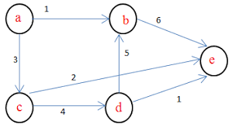
Dijkstra’s Algorithm Problems

Slide 67
Time Complexity
This case is valid when-
The given graph G is represented as an adjacency matrix.
Priority queue Q is represented as an unordered list.
Here, A[i, j] stores the information about edge (i, j).
Time taken for selecting i with the smallest dist is O(V).
For each neighbour of i, time taken for updating dist[j] is O(1) and there will be maximum V neighbours.
Time taken for each iteration of the loop is O(V) and one vertex is deleted from Q.
Thus, total time complexity becomes O(V²).

